Slide 1
Computer Graphics Laboratory
Brick breaker Game
Md.Hasanuzzaman(011142017)
Md. Mominul Islam(011142007)

Slide 2
Introduction
Component
Rule
Score

Slide 3
Task.
UI
Logic

Slide 4
UI
Some Methods
Draw Bricks
Draw Ball
Draw Bar

Slide 5
Logic
Some Tricks
structure programming
Window Size
Other Calculations

Slide 6
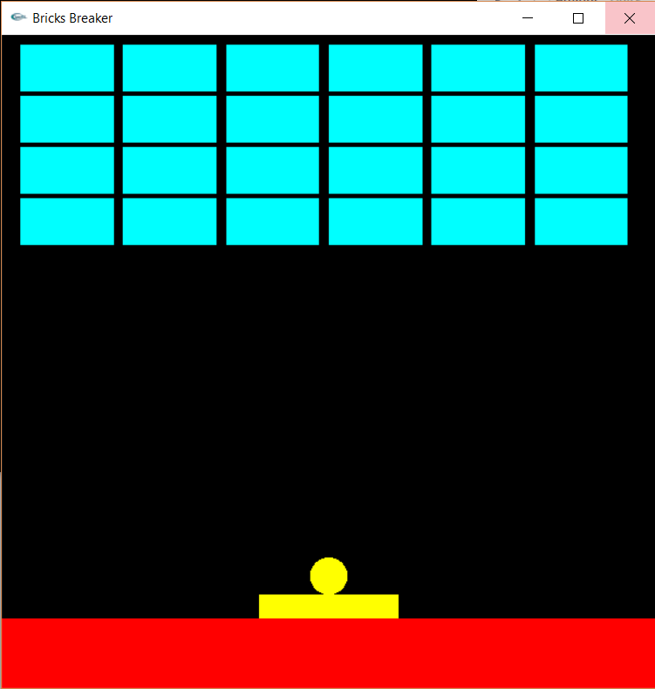
Screenshot

Slide 7
Difficulty
Less knowledge of C++ oop.
Very Short Time.

Slide 8
Thank You.

